Slide 1
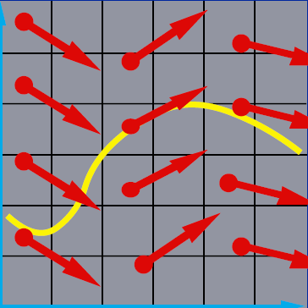
Numerical Solution of Ordinary Differentiation Equations
x₂
x₁

Slide 2
Outline
Higher-order equations and systems
Boundary value problem
Shooting method
Finite difference method
Summary of Chapter 6

Slide 3
Higher-Order Equations and Systems
Recall that a higher-order equation can be converted into a system of 1st-order equation
…

Slide 4
Higher-Order Equations and Systems
n-dimensional ODE can be formulated as a system of 1st order equation
Either case can be handled as solving a system of 1st-order ODEs

Slide 5
Example: Ex 47 on pp 397
Solve
Convert to a system of 1st order ODE

Slide 6
Example: Ex 47 on pp 397
Solving with Euler’s method

Slide 7
Example: Ex 47 on pp 397
Solving with Euler’s method

Slide 8
Example: System of two 1st-order ODEs
Solving
Equivalent to solving

Slide 9
Example (cont.)
Solving
Using Euler’s method

Slide 10
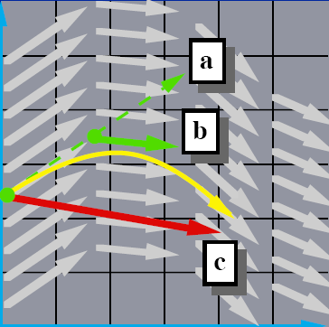
Note: Euler’s Method and Its Variant
Euler
Implicit Euler
Midpoint
Modified Euler: used in predictor-corrector scheme

Slide 11
Example: Euler Predictor-Corrector Method
Predictor: Euler’s Method
Corrector: modified Euler

Slide 12
Example: Euler Predictor-Corrector Method
Euler’s Method
Predictor
Corrector
Notes:
when computing x_2^1, we can use x_1^1=0.9145, the best value we have obtained!

Slide 13
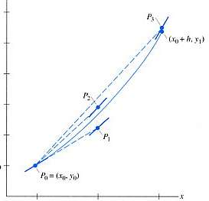
Example: Runge-Kutta method
Solving
Using Runge-Kutta method
k_{1,1}
k_{1,2}

Slide 14
Example (cont.)
Solving
Using Runge-Kutta method

Slide 15
Example (cont.)
Compute k3, k4 accordingly, we can obtain
Trace the example on pages 361-363 of the textbook by yourself!

Slide 16
Using ODE solver in Matlab
ode45 is based on Runge-Kutta-Felhberg method
Usage:
@f is a function handler of a function f
dxdt = f(t,x) is the ODE to be solved
The first argument needs to be t whether f depends on t or not
x and f can be a column vector to represent a system of 1st-order ODEs
[t, x] = ode45(@f, time_span, x(0));

Slide 17
Example: using ode45()
Solving
Code using inline function
%dx/dt = f(t,x) = -x
f = inline('-x', 't', 'x');
[t, x] = ode45(f, [0, 0.1, 0.2, 0.3], -1);
time span
x(0)

Slide 18
Example: using ode45()
Solving
Code using function handler
[t, x] = ode45(@f, [0, 0.1, 0.2, 0.3], -1);
function dxdt = f(t,x)
dxdt = -x;

Slide 19
Example: using ode45()
Solving
Code
[t, x] = ode45(@F, tspan, [1,-1]);
function dXdt = F(t,X)
dXdt = [ X(1)*X(2) + t
t*X(2) + X(1)];

Slide 20
Boundary Value Problems
Let’s consider solving a 2nd-order ODE,
Initial Value Problem (IVP) Conditions are given at the same point
Recall that n auxiliary conditions are needed for solving an nth-order ODE!

Slide 21
Boundary Value Problems
Let’s consider solving a 2nd-order ODE,
Initial Value Problem (IVP) Conditions are given at the same point
Boundary Value Problem (BVP) Conditions are given at different points

Slide 22
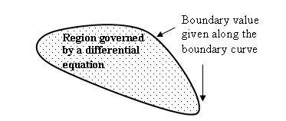
Boundary Value Problems (cont.)
Auxiliary conditions are often specified at boundaries of the domain, so the problem is usually called Boundary Value Problem
From Wikipedia

Slide 23
Shooting Method
Converts the boundary value problem into an equivalent initial value problem

Slide 24

Example: Shooting Method
Solve for y(t), altitude of rocket, given
y” = -g
g = 9.8 m/s²
y(0) = 0 (launch from ground)
y(5) = 40 (reach 40 m off ground after 5 seconds)
y(5)=40
Paul Heckbert,
http://www.cs.cmu.edu/~ph/859B/www/notes/ode/bvp.html
y(0)=0

Slide 25
Example (cont.)
Use Euler’s method to solve the IVP with different guesses of initial speeds

Slide 26
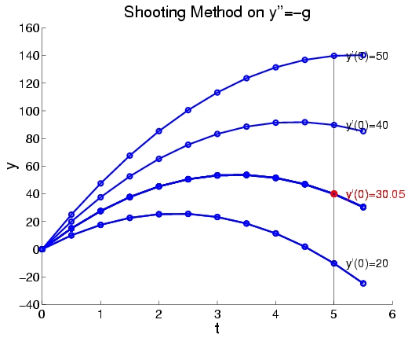
Example (cont.)
Solutions obtained with different initial speeds v₀ using h = 0.5
Correct answer is v₀ =y’(0)=32.5

Slide 27
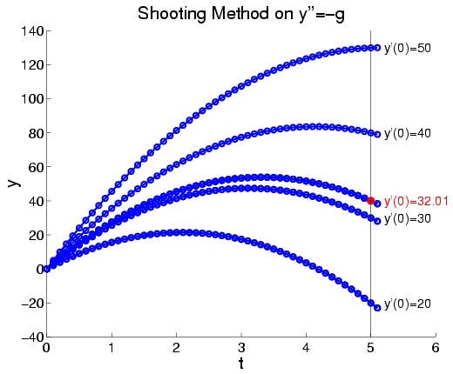
Example (cont.)
Solutions obtained with different initial speeds v₀ using h = 0.1
Error is due to the inaccuracy of Euler’s method
Better accuracy can be achieved using other methods

Slide 28
Example (cont.)
‘Initial speed finding’ can be considered as a root finding problem.
Let be the solution curve with initial conditions y(0) = y₀ and y’(0) = v₀
The initial speed v₀ that satisfies the boundary condition y(5) = 40 is the root of

Slide 30
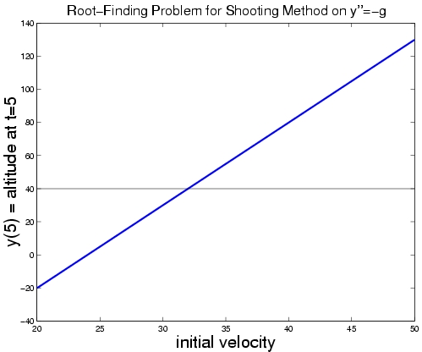
Root-Finding for Shooting Method
v₀ = 32.5
Notes:
S=v0*t+0.5(-g)*t^2 → 40 = 5*v0 -4.9*25 → v0 = 32.5

Slide 31
Shooting Method for Linear BVP
For a linear BVP, P(v₀) is linear and we can obtain the correct answer by interpolating between a pair of computed values
y’(0)
y(5)
50
127.5
20
-22.5
v₀
40
v₀ = 32.5

Slide 32
Shooting Method for Nonlinear BVP
For a nonlinear BVP, P(v₀) is nonlinear; root finding method can be applied
If P(v₀) and its derivative function are available, Newton’s method can be used
In general, P(v₀) and dP(v₀)/dv₀ are complicate or unavailable, secant method is recommended since it only needs function values

Slide 33
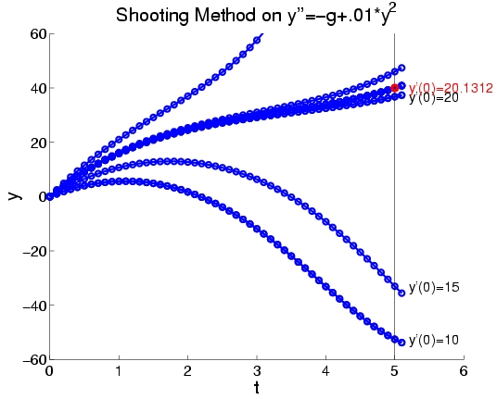
Example: Nonlinear BVP
Paul Heckbert, http://www.cs.cmu.edu/~ph/859B/www/notes/ode/bvp.html

Slide 34
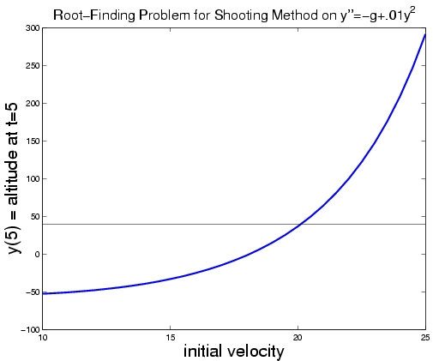
Example (cont.)
Paul Heckbert, http://www.cs.cmu.edu/~ph/859B/www/notes/ode/bvp.html
Notes:
Y(5) =

Slide 35
Example 6.2
Using shooting methods -- converting to IVP

Slide 36
Example 6.2 (cont.)
Using RKF as the IVP solver
function dUdx = F(x,U)
dUdx = [ U(2)
(1-x/5)*U(1)+x];
[x, U] = ode45(@F, 1:0.2:3, U0);

Slide 37
Example 6.2 (cont.)
Define the nonlinear function to be solved
Find u’(1) that satisfy u(3) = -1 → P(u’(1))+1 = 0
Secant method with u’(1) = -1.5 and u’(1) = -3
function P = shooting(U0)
[x,U]=ode45(@F, 1:0.2:3, U0);
P=U(length(x),1)+1;
U3 = secant(@shooting, [2, -1.5], [2, -3], 1e-5)
Notes:
Secant method for finding the root of P(v) = u(3,v) + 1 = 0
where u(x,v) is the solution curve u(x) obtained with initial velocity v
u(3,v) is then a curve when x=3.
Or P(v) can be simply expressed as P(v)+1=0, where v=u’(1) is unknown to be determined by root finding.
Note u(3) = U(length(x),1) since the end point (last point) of u(x) is x=3,

Slide 38
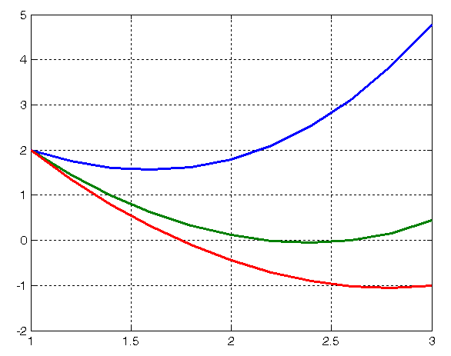
Example 6.2 (cont.)
See shooting_demo.m on the course web
u’(1) = -1.5
u’(1) = -3
u’(1) = -3.459

Slide 39
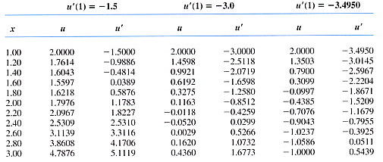
Example 6.2 (cont.)
Secant method converges at one step
Using shooting method (IVP solver: RKF)

Slide 40
Example: Shooting Method
http://www.cs.illinois.edu/~heath/iem/ode/shoot/

Slide 41
Finite Difference Method
Converts BVP into a system of algebraic equations by replacing derivatives with finite difference approximation
Consider solving a two-point BVP
Divide [a, b] into n subintervals
x₀=x(a)
x_{i}=x(t_{i})
x_{n}=x(b)
a
t_{i}=a+ih
b

Slide 42
Finite Difference Method
Solving can be converted into solving a system of algebraic equations
The system can be linear or nonlinear
depending on whether f is linear or nonlinear in x and x’
Central difference

Slide 43
Example: finite difference method
Solving y” = -g with y(0)=0, y(5)=40
Using the formula
Dividing [0,5] into 10 subintervals, we get

Slide 44
Example (cont.)
y” = -g, y(0)=0, y(5)=40
Solving linear system Ay=b
1 0 0 0 0 0 0 0 0 0 0
1 -2 1 0 0 0 0 0 0 0 0
0 1 -2 1 0 0 0 0 0 0 0
0 0 1 -2 1 0 0 0 0 0 0
0 0 0 1 -2 1 0 0 0 0 0
0 0 0 0 1 -2 1 0 0 0 0
0 0 0 0 0 1 -2 1 0 0 0
0 0 0 0 0 0 1 -2 1 0 0
0 0 0 0 0 0 0 1 -2 1 0
0 0 0 0 0 0 0 0 1 -2 1
0 0 0 0 0 0 0 0 0 0 1
0
-2.4500
-2.4500
-2.4500
-2.4500
-2.4500
-2.4500
-2.4500
-2.4500
-2.4500
40.0000
0
15.0250
27.6000
37.7250
45.4000
y = 50.6250
53.4000
53.7250
51.6000
47.0250
40.0000
=

Slide 45
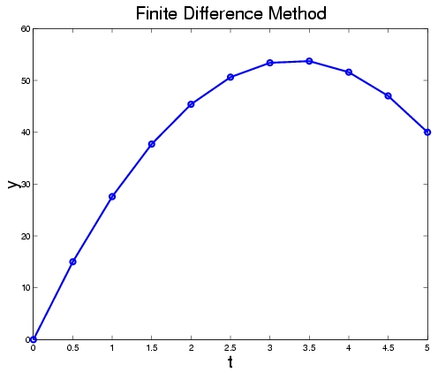
Example (cont.)
0
15.0250
27.6000
37.7250
45.4000
y = 50.6250
53.4000
53.7250
51.6000
47.0250
40.0000
Initial speed is
30.05(linear est.)
32.5 (quadratic)
32.5 (correct)

Slide 46
Derivative Boundary Conditions
Example 6.7
Using finite-difference method (4 subintervals)
u₀
u₄
1
3

Slide 47
Example 6.7

Slide 48
Example 6.8
Solving Ex 6.7 using Shooting method
Converting to IVP by guessing u(1)
x u(x) u’(x) u(x) u’(x) u(x) u’(x) True
1.0000 1.0000 1.1752 2.0000 1.1752 1.5432 1.1752 1.5431
1.5000 1.7400 1.8463 2.8676 2.3674 2.3525 2.1293 2.3524
2.0000 2.9242 2.9886 4.4673 4.1638 3.7624 3.6270 3.7622
2.5000 4.8547 4.8938 7.2071 7.0231 6.1325 6.0504 6.1323
3.0000 8.0245 8.0482 11.7867 11.6751 10.0681 10.0183 10.0677
Notes:
We need to find a u(1) such that u’(3) = 10.01787. Treat this as a root finding problem, and solve it by iteratively guessing.
Suppose we start from u(1) = 1, we obtain u’(3) = 8.0482, which is smaller than u’(3). We then try u(1) = 2, which gives u’(3) = 11.6751.
We can do a third guess by linear interpolation, i.e., treat (u(1), u’(3)), (1, 8.0482) (2, 11.6751) as a line, given u’(3) = 10.01787, u(1) would be 1.5432.

Slide 49
BVP solver in Matlab
Matlab Central
Jacek Kierzenka has a good tutorial for bvp4c
dslove()
Symbolic ODE solver
See also Philip Yecko’s ODEs and PDEs with MATLAB Workshop
http://www.csam.montclair.edu/~yecko/odepdematlab/

Slide 50
Summary of Numerical Solution of ODE
Visualization of numerically solving ODE
Error
Global error vs. Local error
Propagated error
Stability
Stability of analytical solution
Stability of numerical solution—growth factor
Solving initial value problems
Solving boundary value problems
x₂
x₁

Slide 51
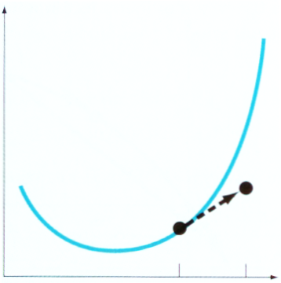
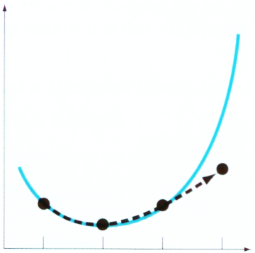
Solving Initial Value Problem
x(t)
Single step method
Euler’s Method
Runge-Kutta method
Multistep method
Adams method
Methods of undetermined coefficients
Adams-Moulton method
Predictor-corrector scheme
Stiff equations and implicit method
t
x(t)
t

Slide 52
Solving Boundary Value Problem
Shooting method
Finite difference method

